Slide 1
Dynamodb Data Modelling
Anju munoth

Slide 2
RDBMS vs NoSQL
RDBMS | NoSQL
Data can be queried flexibly, but queries are relatively expensive and don't scale well in high-traffic situations | Data can be queried efficiently in a limited number of ways, outside of which queries can be expensive and slow.
In RDBMS, you design for flexibility without worrying about implementation details or performance. | In DynamoDB, you design your schema specifically to make the most common and important queries as fast and as inexpensive as possible.
Query optimization generally doesn't affect schema design, but normalization is important. | Data structures are tailored to the specific requirements of your business use cases.

Slide 3
Two key concepts for NoSQL design
Shouldn't start designing your schema for DynamoDB until you know the questions it will need to answer.
Understanding the business problems and the application use cases up front is essential.
Should maintain as few tables as possible in a DynamoDB application.
Having fewer tables keeps things more scalable, requires less permissions management, and reduces overhead for your DynamoDB application.
Can also help keep backup costs lower overall.

Slide 4
Approaching NoSQL design
Data size: Knowing how much data will be stored and requested at one time will help determine the most effective way to partition the data.
Data shape: Instead of reshaping data when a query is processed (as an RDBMS system does), a NoSQL database organizes data so that its shape in the database corresponds with what will be queried.
Key factor in increasing speed and scalability.
Data velocity: DynamoDB scales by increasing the number of physical partitions that are available to process queries, and by efficiently distributing data across those partitions.
Knowing in advance what the peak query loads will be might help determine how to partition data to best use I/O capacity.

Slide 5
Performance principles
Keep related data together. "locality of reference" -- most important factor in speeding up response time: keeping related data together in one place.
Has a major impact on cost and performance.
Instead of distributing related data items across multiple tables, you should keep related items in your NoSQL system as close together as possible.
As a general rule, should maintain as few tables as possible in a DynamoDB application.
Exceptions are cases where high-volume time series data are involved, or datasets that have very different access patterns.
A single table with inverted indexes can usually enable simple queries to create and retrieve the complex hierarchical data structures required by your application.

Slide 6
Performance principles
Use sort order. Related items can be grouped together and queried efficiently if their key design causes them to sort together.
Distribute queries. High volume of queries need not be focused on one part of the database, where they can exceed I/O capacity.
Design data keys to distribute traffic evenly across partitions as much as possible, avoiding "hot spots."
Use global secondary indexes. By creating specific global secondary indexes, you can enable different queries than your main table can support, and that are still fast and relatively inexpensive.

Slide 7
How to improve performance
Ability to use computing resources efficiently to meet system requirements,
Maintain that efficiency as demand changes and technologies evolve.
Performance revolve around modeling the data , choosing partition keys and sort keys , and defining secondary indexes based on the application access patterns.
Choosing the optimal throughput mode for the workload, AWS SDK tuning and, when appropriate, using an optimal caching strategy.

Slide 8
Cost optimization
Avoiding unnecessary costs.
Understanding and controlling where money is being spent, selecting the most appropriate and right number of resource types, analyzing spend over time, designing your data models to optimize the cost for application-specific access patterns, and scaling to meet business needs without overspending.
Choosing the most appropriate capacity mode and table class for your tables and avoiding over-provisioning capacity by either using the on-demand capacity mode, or provisioned capacity mode with autoscaling.
Efficient data modeling and querying to reduce the amount of consumed capacity, reserving portions of the consumed capacity at discounted price, minimizing item size, identifying and removing unused resources and using TTL to automatically delete aged-out data at no cost.

Slide 9
Operational excellence
Running and monitoring systems to deliver business value, and continually improving processes and procedures.
Automating changes, responding to events, and defining standards to manage daily operations.
Monitoring DynamoDB metrics through Amazon CloudWatch and AWS Config and automatically alert and remediate when predefined thresholds are breached, or non compliant rules are detected.
Defining DynamoDB resources via infrastructure as a code and leveraging tags for better organization, identification and cost accounting of your DynamoDB resources.

Slide 10
Reliability
Ensuring a workload performs its intended function correctly and consistently when it’s expected to.
Resilient workload quickly recovers from failures to meet business and customer demand.
Distributed system design, recovery planning, and how to handle change.
Running and monitoring systems to deliver business value, and continually improving processes and procedures.
Automating changes, responding to events, and defining standards to manage daily operations.
Choosing the backup strategy and retention based on your RPO and RTO requirements, using DynamoDB global tables for multi-regional workloads, or cross-region disaster recovery scenarios with low RTO, implementing retry logic with exponential backoff in the application by configuring and using these capabilities in the AWS SDK
Monitoring DynamoDB metrics through Amazon CloudWatch and automatically alerting and remediating when predefined thresholds are breached.

Slide 11
Security
Focuses on protecting information and systems.
Confidentiality and integrity of data, identifying and managing who can do what with privilege management, protecting systems, and establishing controls to detect security events.
Encrypting data in transit with HTTPS, choosing the type of keys for data at rest encryption and defining the IAM roles and policies to authenticate, authorize and provide fine grain access to DynamoDB resources.
Auditing DynamoDB control plane and data plane operations through AWS CloudTrail.

Slide 12
Sustainability
Minimizing the environmental impacts of running cloud workloads.
Shared responsibility model for sustainability, understanding impact, and maximizing utilization to minimize required resources and reduce downstream impacts.
Identifying and removing unused DynamoDB resources, avoiding over-provisioning though the usage of on-demand capacity mode or provisioned capacity-mode with autoscaling, efficient querying to reduce the amount of capacity being consumed and reduction of the storage footprint by compressing data and by deleting aged-out data through the use of TTL.

Slide 13
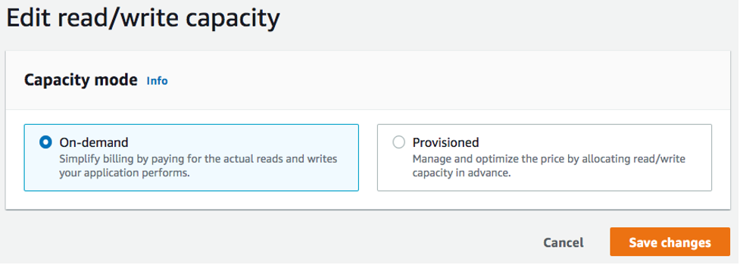
Table capacity mode
Select either on-demand or provisioned capacity mode.
Can change this setting twice in a 24-hour period

Slide 14
On-demand capacity mode
On-demand capacity mode is designed to eliminate the need to plan or provision the capacity of your DynamoDB table.
Table will instantly accommodate requests to your table without the need to scale any resources up or down (up to twice the previous peak throughput of the table).
On-demand tables are billed by counting the number of actual requests against the table, so you will only pay for what you use rather than what has been provisioned.

Slide 15
Provisioned capacity mode
More traditional model where you can define how much capacity the table has available for requests either directly or with the assistance of auto-scaling.
Because a specific capacity is provisioned for the table at any given time, billing is based off of the capacity provisioned rather than the number of requests.
Going over the allocated capacity can also cause the table to reject requests and reduce the experience of your applications users.
Provisioned capacity mode requires a balance between not overprovisioning or under provisioning the table to keep both throttling low and costs tuned.

Slide 16
When to select on-demand capacity mode
When optimizing for cost, on-demand mode is your best choice when you have a workload similar to the following graph.
Following factors contribute to this type of workload:
Unpredictable request timing (resulting in traffic spikes)
Variable volume of requests (resulting from batch workloads)
Drops to zero or below 18% of the peak for a given hour (resulting from dev or test environments)

Slide 17
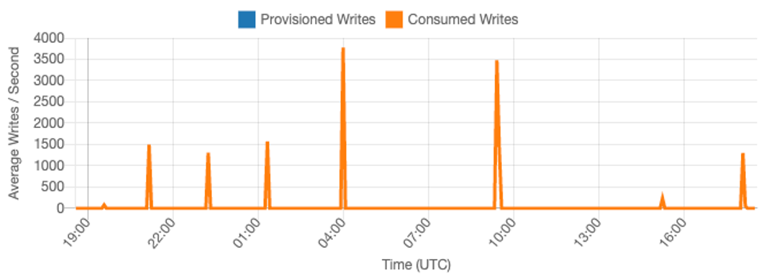
For workloads with the above factors, using Auto-Scaling to maintain enough capacity on the table to respond to spikes in traffic will likely lead to the table being overprovisioned and costing more than necessary or the table being under provisioned and requests being unnecessarily throttled.
Because on-demand tables are billed by request, there is nothing further we need to do at the table level to optimize for cost.
Should regularly evaluate your on-demand tables to verify the workload still has the above factors.
If the workload has stabilized, consider changing to provisioned mode to further optimize cost.

Slide 18
When to select provisioned capacity mode
An ideal workload for provisioned capacity mode is one with a more predictable usage pattern like the graph below.
Following factors contribute to this type of workload:
Predicable/cyclical traffic for a given hour or day
Limited short term bursts of traffic

Slide 19
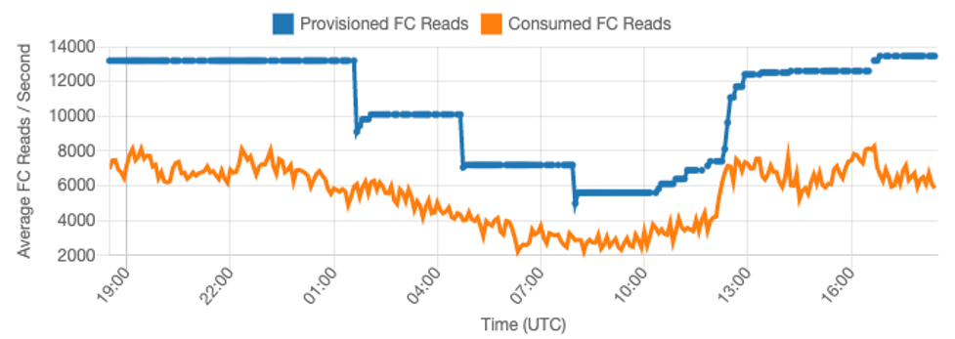
Since the traffic volumes within a given hour or day are more stable, we can set the provisioned capacity of the table relatively close to the actual consumed capacity of the table.
Cost optimizing a provisioned capacity table is ultimately an exercise in getting the provisioned capacity (blue line) as close to the consumed capacity (orange line) as possible without increasing ThrottledRequests on the table.
Space between the two lines is both wasted capacity as well as insurance against a bad user experience due to throttling.

Slide 20
Auto Scaling
DynamoDB provides auto scaling for provisioned capacity tables which will automatically balance the provisioned capacity and consumed capacity
Lets you track your consumed capacity throughout the day and set the capacity of the table based on a handful of variables

Slide 21
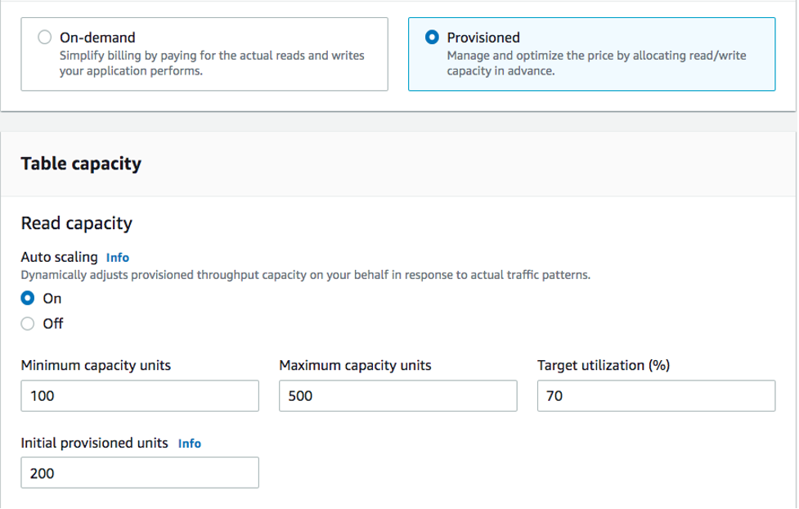

Slide 22
Auto Scaling
Minimum capacity units
Can set the minimum capacity of a table to limit throttling, but it will not reduce the cost of the table.
If your table has periods of low usage follow by a sudden burst of high usage, setting the minimum can prevent auto scaling from setting the table capacity too low.
Maximum capacity units
Can set the maximum capacity of a table to limit a table scaling higher than intended.
Consider applying a maximum for Dev or Test tables where large-scale load testing is not desired.
Can set a maximum for any table, but be sure to regularly evaluate this setting against the table baseline when using it in Production to prevent accidental throttling.

Slide 23
Auto Scaling
Target utilization
Setting the target utilization of the table is the primary means of cost optimization for a provisioned capacity table.
Setting a lower percent value here will increase how much the table is overprovisioned, increasing cost, but reducing the risk of throttling.
Setting a higher percent value will decrease how much the table is overprovisioned, but increase the risk of throttling.

Slide 24
Understanding auto scaling settings
Defining the correct value for the target utilization, initial step, and final values is an activity that requires involvement from your operations team.
Allows to properly define the values based on historical application usage, which will be used to trigger the AWS auto scaling policies.
The utilization target is the percentage of your total capacity that needs to be hit during a period of time before the auto scaling rules apply.
When you set a high utilization target (a target around 90%) it means your traffic needs to be higher than 90% for a period of time before the auto scaling kicks in.
Should not use a high utilization target unless your application is very constant and doesn’t receive spikes in traffic.
When you set a very low utilization (a target less than 50%) it means your application would need to reach 50% of the provisioned capacity before it triggers an auto scaling policy.
Unlless your application traffic grows at a very aggressive rate, this usually translates into unused capacity and wasted resources.

Slide 25
Workloads with seasonal variance
Application is operating under a minimum average value most of the time, but the utilization target is low so your application can react quickly to events that happen at certain hours in the day and you have enough capacity and avoid getting throttled.
This scenario is common when you have an application that is very busy during normal office hours (9 AM to 5 PM) but then it works at a base level during after hours.
Since some users will start to connect before 9 am, the application uses this low threshold to ramp up quickly to get to the required capacity during peak hours.
This scenario could look like this:
Between 5 PM and 9 AM the ConsumedWriteCapacity units stay between 90 and 100
Users start to connect to the application before 9 AM and the capacity units increases considerably (the maximum value you’ve seen is 1500 WCU)
On average, your application usage varies between 800 to 1200 during working hours

Slide 26
Workloads with seasonal variance
consider using scheduled auto scaling, where your table could still have an application auto scaling rule configured, but with a less aggressive target utilization that only provisions the extra capacity at the specific intervals you require.

Slide 27
Choosing a table capacity mode
Reserved capacity
For provisioned capacity tables, DynamoDB offers the ability to purchase reserved capacity for your read and write capacity (replicated write capacity units (rWCU) and Standard-IA tables are currently not eligible).
If you chose to purchase reservations for this capacity, you can reduce the cost of the table by a significant percent.
When deciding between the two table modes, consider how much this additional discount will affect the cost of the table.
In many cases, even a relatively unpredictable workload can be cheaper to run on an overprovisioned provisioned capacity table with reserved capacity.

Slide 28
Improving predictability of your workload
Workload may seemingly have both a predictable and unpredictable pattern.
While this can be easily supported with an on-demand table, costs will likely be better if the unpredictable patterns in the workload can be improved.
One of the most common causes of these patterns is batch imports.
This type of traffic can often exceed the baseline capacity of the table to such a degree that throttling would occur if it were to run.
To keep a workload like this running on a provisioned capacity table, consider the following options:
If the batch occurs at scheduled times, you can schedule an increase to your auto- scaling capacity before it runs
If the batch occurs randomly, consider trying to extend the time it runs rather than executing as fast as possible
Add a ramp up period to the import where the velocity of the import starts small but is slowly increased over a few minutes until auto-scaling has had the opportunity to start adjusting table capacity

Slide 29
Encryption at rest
All user data stored in Amazon DynamoDB is fully encrypted at rest.
DynamoDB encryption at rest provides enhanced security by encrypting all your data at rest using encryption keys stored in AWS Key Management Service (AWS KMS).
Reduces the operational burden and complexity involved in protecting sensitive data.
Can build security-sensitive applications that meet strict encryption compliance and regulatory requirements.

Slide 30
Encryption at rest
Provides an additional layer of data protection by always securing your data in an encrypted table—including its primary key, local and global secondary indexes, streams, global tables, backups, and DynamoDB Accelerator (DAX) clusters whenever the data is stored in durable media.
Organizational policies, industry or government regulations, and compliance requirements often require the use of encryption at rest to increase the data security of your applications.
Encryption at rest integrates with AWS KMS for managing the encryption keys that are used to encrypt your tables

Slide 31
Encryption at rest
When creating a new table, you can choose one of the following AWS KMS key types to encrypt your table.
Can switch between these key types at any time.
AWS owned key – Default encryption type. The key is owned by DynamoDB (no additional charge).
AWS managed key – The key is stored in your account and is managed by AWS KMS (AWS KMS charges apply).
Customer managed key – The key is stored in your account and is created, owned, and managed by you. You have full control over the KMS key (AWS KMS charges apply).

Slide 32
Security best practices
Encryption at rest
DynamoDB encrypts at rest all user data stored in tables, indexes, streams, and backups using encryption keys stored in AWS Key Management Service (AWS KMS).
This provides an additional layer of data protection by securing your data from unauthorized access to the underlying storage .
Can specify whether DynamoDB should use an AWS owned key (default encryption type), an AWS managed key, or a customer managed key to encrypt user data.

Slide 33
Security best practices
Use IAM roles to authenticate access to DynamoDB
For users, applications, and other AWS services to access DynamoDB, they must include valid AWS credentials in their AWS API requests.
Should not store AWS credentials directly in the application or EC2 instance.
These are long-term credentials that are not automatically rotated, and therefore could have significant business impact if they are compromised.
An IAM role enables you to obtain temporary access keys that can be used to access AWS services and resources.

Slide 34
Security best practices
Use IAM policies for DynamoDB base authorization
When granting permissions, you decide who is getting them, which DynamoDB APIs they are getting permissions for, and the specific actions you want to allow on those resources. Implementing least privilege is key in reducing security risk and the impact that can result from errors or malicious intent.
Attach permissions policies to IAM identities (that is, users, groups, and roles) and thereby grant permissions to perform operations on DynamoDB resources

Slide 35
Security best practices
Use IAM policy conditions for fine-grained access control
When you grant permissions in DynamoDB, you can specify conditions that determine how a permissions policy takes effect.
Implementing least privilege is key in reducing security risk and the impact that can result from errors or malicious intent.
Can specify conditions when granting permissions using an IAM policy.
For example, you can do the following:
Grant permissions to allow users read-only access to certain items and attributes in a table or a secondary index.
Grant permissions to allow users write-only access to certain attributes in a table, based upon the identity of that user.

Slide 36
Monitoring in DynamoDB
AWS provides tools that you can use to monitor DynamoDB.
Can configure some of these tools to do the monitoring for you;
Some require manual intervention.

Slide 37
Automated monitoring tools
Can use the following automated monitoring tools to watch DynamoDB and report when something is wrong:
Amazon CloudWatch Alarms – Watch a single metric over a time period that you specify, and perform one or more actions based on the value of the metric relative to a given threshold over a number of time periods.
The action is a notification sent to an Amazon Simple Notification Service (Amazon SNS) topic or Amazon EC2 Auto Scaling policy.
CloudWatch alarms do not invoke actions simply because they are in a particular state; the state must have changed and been maintained for a specified number of periods.
Amazon CloudWatch Logs – Monitor, store, and access your log files from AWS CloudTrail or other sources.
Amazon CloudWatch Events – Match events and route them to one or more target functions or streams to make changes, capture state information, and take corrective action.
AWS CloudTrail Log Monitoring – Share log files between accounts, monitor CloudTrail log files in real time by sending them to CloudWatch Logs, write log processing applications in Java, and validate that your log files have not changed after delivery by CloudTrail

Slide 38
Manual monitoring tools
Another important part of monitoring DynamoDB involves manually monitoring those items that the CloudWatch alarms don't cover.
DynamoDB, CloudWatch, Trusted Advisor, and other AWS console dashboards provide an at-a-glance view of the state of your AWS environment.
DynamoDB dashboard shows:
Recent alerts
Total capacity
Service health

Slide 39
Manual monitoring tools
CloudWatch home page shows:
Current alarms and status
Graphs of alarms and resources
Service health status
In addition, can use CloudWatch to do the following:
Create customized dashboards to monitor the services you care about
Graph metric data to troubleshoot issues and discover trends
Search and browse all of your AWS resource metrics
Create and edit alarms to be notified of problems

Slide 40
Logging DynamoDB operations by using AWS CloudTrail
DynamoDB is integrated with AWS CloudTrail, a service that provides a record of actions taken by a user, role, or an AWS service in DynamoDB.
CloudTrail captures all API calls for DynamoDB as events.
The calls captured include calls from the DynamoDB console and code calls to the DynamoDB API operations.
If you create a trail, you can enable continuous delivery of CloudTrail events to an Amazon S3 bucket, including events for DynamoDB.
If you don't configure a trail, you can still view the most recent events in the CloudTrail console in Event history.
Using the information collected by CloudTrail, you can determine the request that was made to DynamoDB, the IP address from which the request was made, who made the request, when it was made, and additional details.
For robust monitoring and alerting, you can also integrate CloudTrail events with Amazon CloudWatch Log

Slide 41
Integrating with Amazon S3
Amazon DynamoDB import and export capabilities provide a simple and efficient way to move data between Amazon S3 and DynamoDB tables without writing any code.
DynamoDB import and export features help you move, transform, and copy DynamoDB table accounts, or AWS.
Can import from S3 sources, and can export DynamoDB table data to Amazon S3 and use AWS services such as Athena, Amazon SageMaker, and AWS Lake Formation to analyze your data and extract actionable insights.
Can also import data directly into new DynamoDB tables to build new applications with single-digit millisecond performance at scale, facilitate data sharing between tables and accounts, and simplify your disaster recovery and business continuity plans.

Slide 42
DynamoDB data export to Amazon S3: how it works
Using DynamoDB table export, can export data from an Amazon DynamoDB table from any time within your point-in-time recovery window to an Amazon S3 bucket.
DynamoDB table export is a fully managed solution for exporting DynamoDB tables at scale, and is much faster than other workarounds involving table scans.
Exporting a table does not consume read capacity on the table, and has no impact on table performance and availability.
Can export table data to an S3 bucket owned by another AWS account, and to a different Region than the one your table is in.
Data is always encrypted end-to-end.
Can export a DynamoDB table using the AWS Management Console, the AWS Command Line Interface, or the DynamoDB API.

Slide 43
DynamoDB data export to Amazon S3: how it works
To export data from an Amazon DynamoDB table to an Amazon S3 bucket, point-in-time recovery (PITR) must be enabled on the source table.
Can export table data from any point in time within the PITR window, up to 35 days.
Exporting a table does not consume read capacity on the table, and has no impact on table performance and availability.
Can export table data to an S3 bucket owned by another AWS account, and to a different Region than the one your table is in.
Data is always encrypted at rest and in transit.
Can choose to export your data in either DynamoDB JSON format or Amazon Ion text format.
Up to 300 export tasks, or up to 100 TB of table size, can be exported concurrently.

Slide 44
Requesting an export using the AWS Management Console
Sign in to the AWS Management Console and open the DynamoDB console at https://console.aws.amazon.com/dynamodb/.
In the navigation pane on the left side of the console, choose Exports to S3.
Choose Export to S3.
Choose a source table and destination S3 bucket.
If the destination bucket is owned by your account, you can use the Browse S3 button to find it.
Otherwise, enter the URL of the bucket using the s3://bucketname/prefix format. the prefix is an optional folder to help keep your destination bucket organized.

Slide 45
Requesting an export using the AWS Management Console
By default, your table will be exported in DynamoDB JSON format from the latest restorable time in the point in time recovery window and encrypted using an Amazon S3 key (SSE-S3).
If you want to change these settings, expand the Additional settings section of the page and enter your desired export settings.
Click the Export button to begin the export.

